Slide 1
PROJECT NAME –
STAFF MANAGEMENT SYSTEM
GROUP NAME - REGICIDE
GROUP MEMBERS
AMITESH SINGH(L)
SIMRAN ARORA
ANSH BAHL
ADITYA MISHRA

Slide 2
AIM
Our Aim is to design a managing system for smooth running of an Organization. In which the information and the personal detail of every employee will be fed, and it can be accessed by the managing unit of the organization and also by the particular employee with its login credentials anytime , anywhere.

Slide 3
PROJECT EXPLAINATION
It works in a hierarchical manner in an organization.
For example –
As we can take a small organization like – Business process Outsourcing (BPO) system in that the Head of the organization can access, change and manage the data of every person of his/her organization but the planning and service analyst person can only access his/her data and manage or change the data of their lower-level employees. Like this way, our whole program will run in Hierarchy.
ALSO WE ARE INCLUDING SOME FEATURES LIKE - When the agents login with their respective login credentials they will be asked for the face recognition for attendance and it will also calculate their working time as it their will be no activity for 10 minutes then it will automatically get log out ,then again the agent will have to login for their further work so, by this their working time will automatically get recorded which also helps in calculating their salary.

Slide 4
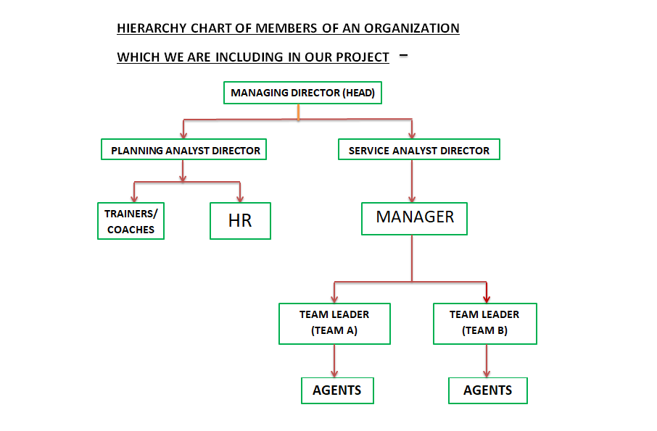

Slide 5
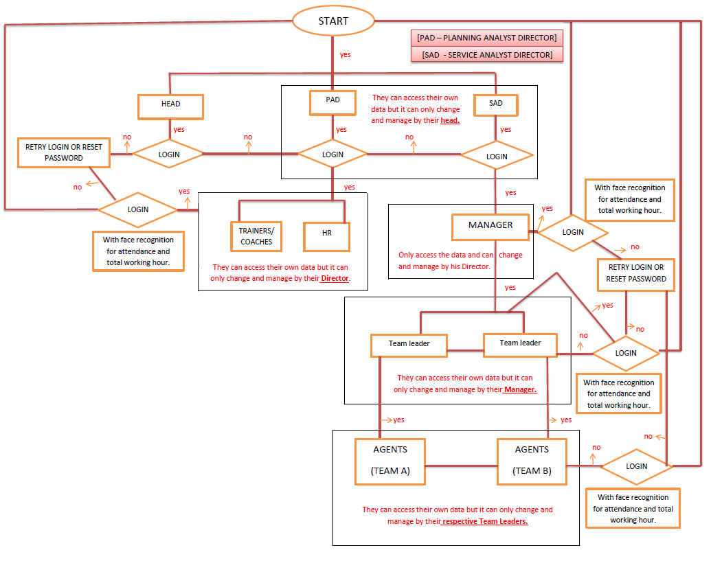
FLOW CHART

Slide 6
FEATURES
SAMPLE OF OUR PROJECT WITH ITS FEATURES AND OUTPUT AT SMALL SCALE BY TAKING SENIOR AND JUNIOR LEVEL OF EMPLOYEES.
For SENIORS
For JUNIORS
To View List of Employees
To View Employee Details
To Modify Existing Employee Details.
To Add New Employee Details.
To Remove an Employee Details.
Access his/her attendance.
Total Working hour.
Salary.
Perks.
Apply for Leave.

Slide 7
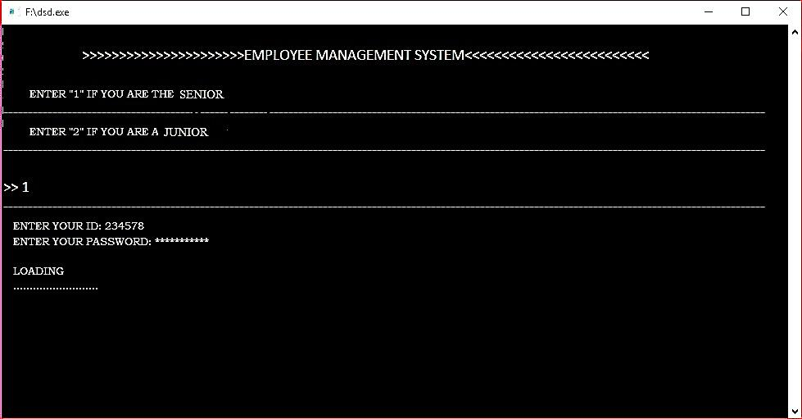
SAMPLE OUTPUT
Here we have to choose option for to login as owner or employee. And firstly we are choosing for OWNER.

Slide 8
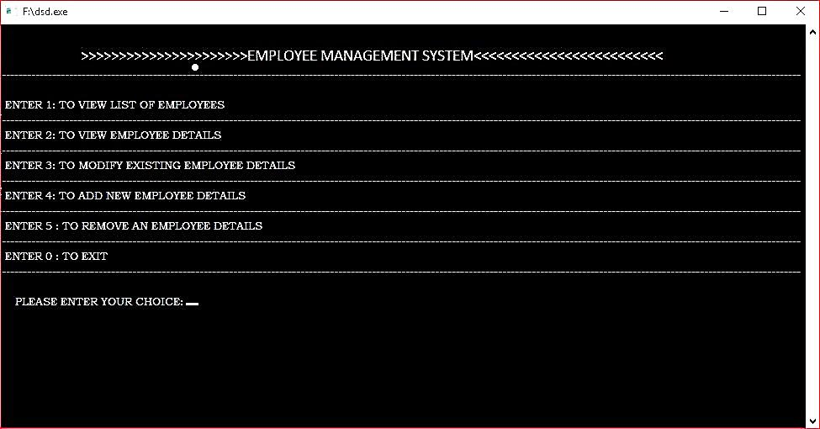
Options for Senior Employee -

Slide 9
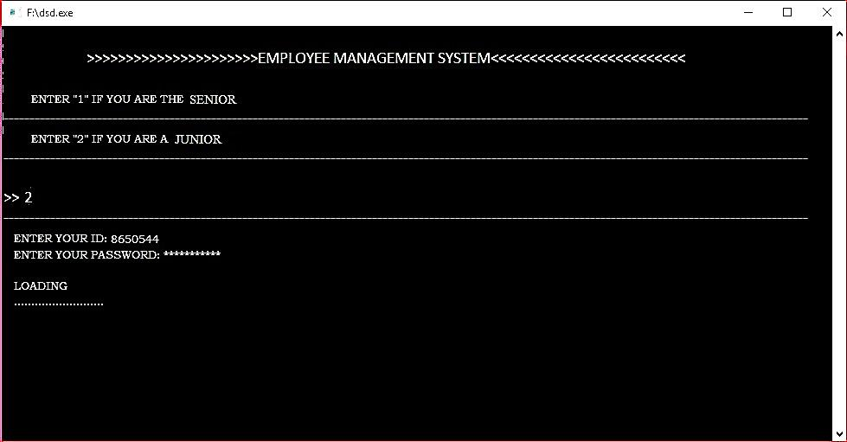
Here we are choosing option for Junior employee . So, that the particular employee will login with his/her login credentials.

Slide 10
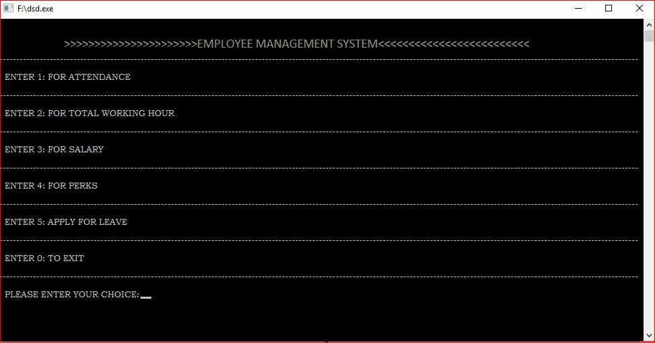
Options for Junior Employee -

Slide 11
THANK YOU

